Slide 1


Slide 2
The complex systems of a car
We have covered simple mechanisms before
Many simple mechanisms make up a part assembly
Now we put them all together to create a complex system, where all parts needs to work together
This is called system integration
Systems integration testing is VERY important
test individual parts & assembly
test overall integration

Slide 3
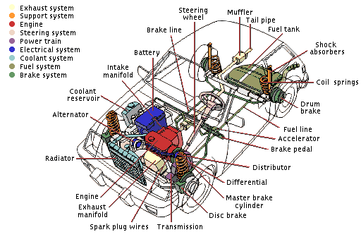
The complex systems of a car

Slide 4
Some car mechanisms & assemblies
Steering mechanism
Engine
Gearbox
Differential
etc.
Fun challenge: see if you can approach the design process of these mechanisms like an engineer

Slide 5
Activity timeeee

